Slide 1

Influences of Social Media on Political Opinions
May,
2025
Team AGLN
Alexander Wischmann
Gabriel Lodi Mendes
Leopold Schönberger
Noel Stein

Slide 2
Agenda
Motivation
Hypothesis
Analysis
Political Views in the US
Media & Social Media Coverage
Social Network Opinion Spread
Conclusion

Slide 3
Importance of Social Media
Motivation
Global Social Media Users
5.3 Billion
253 Million
US Social Media Users
106 Million
US Twitter/X Users
00%
Sources: Data Reportal [1]; Demand Sage [2]

Slide 4
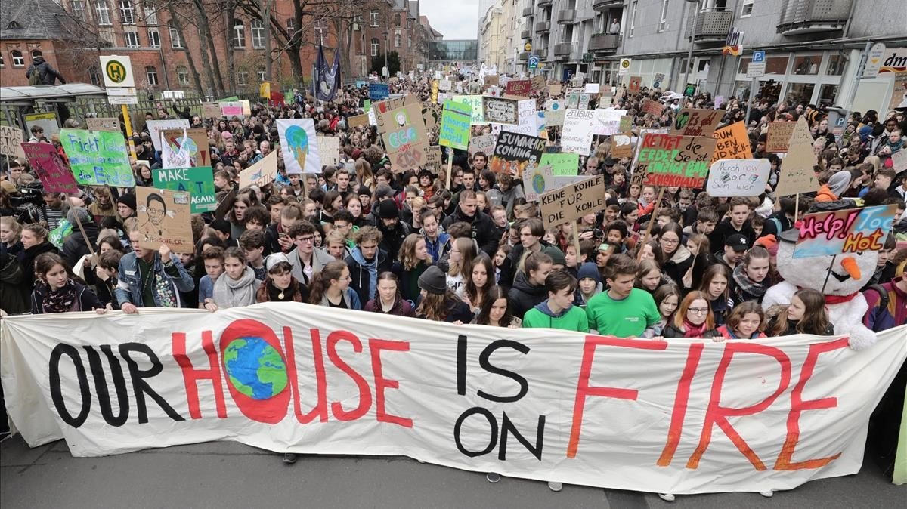
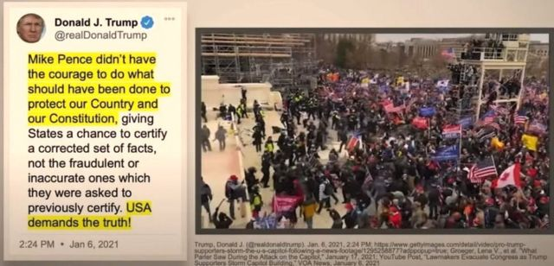
Importance of Social Media
Motivation

Slide 5
Hypothesis
Hypothesis
Social media has changed the spread of political information into a faster-changing and influenced-based environment.

Slide 6
Analysis - Part 1
Political Views in the US

Slide 7



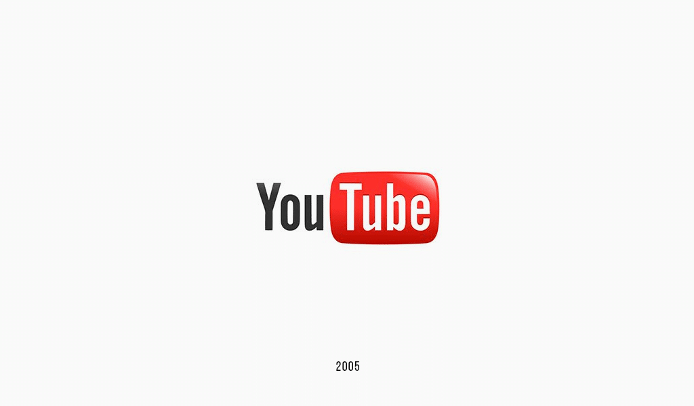

Political Views in the US
2005
2010
2003
2006

Slide 8
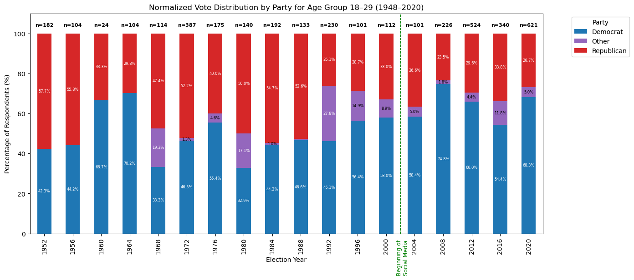
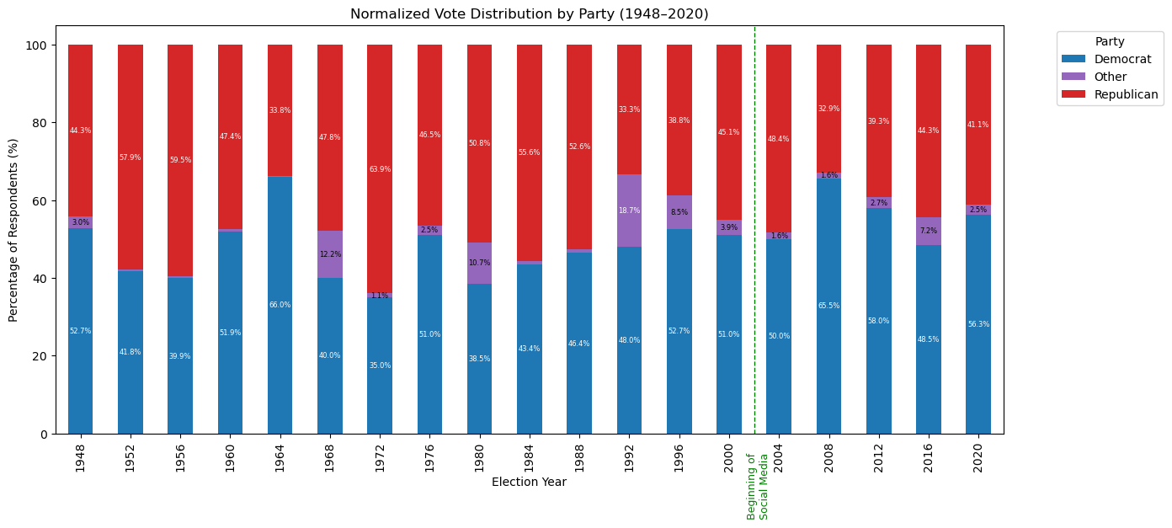
Political Views in the US
Sources: American National Election Studies (ANES) [6]

Slide 9
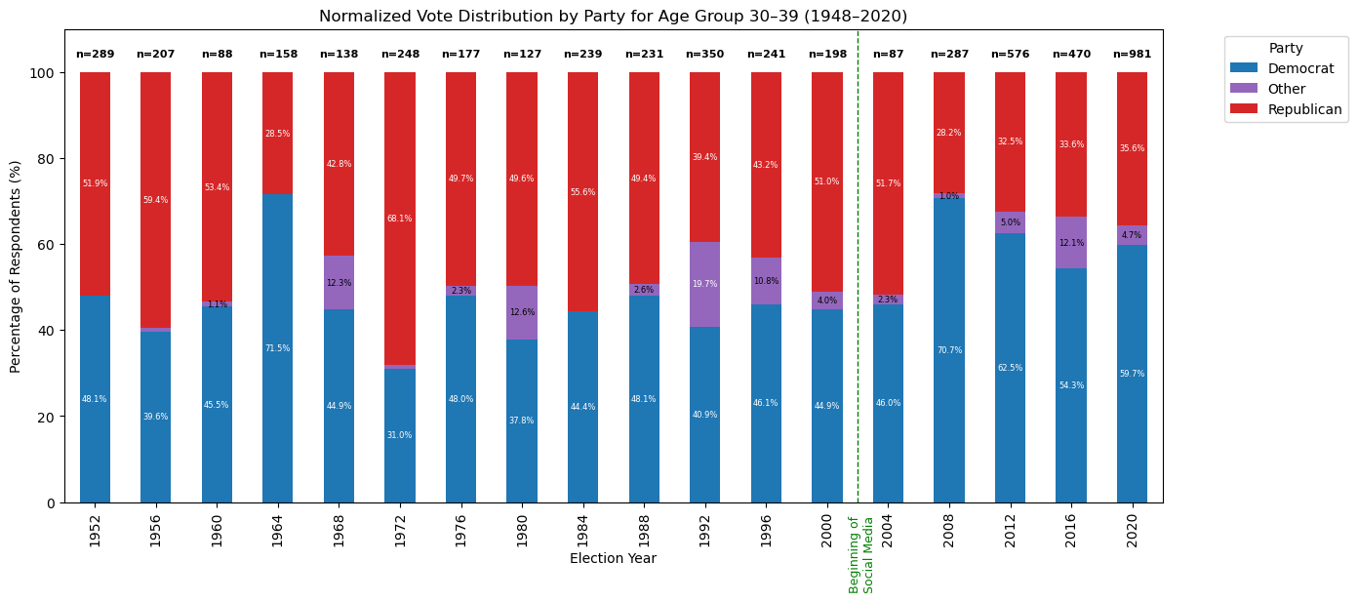
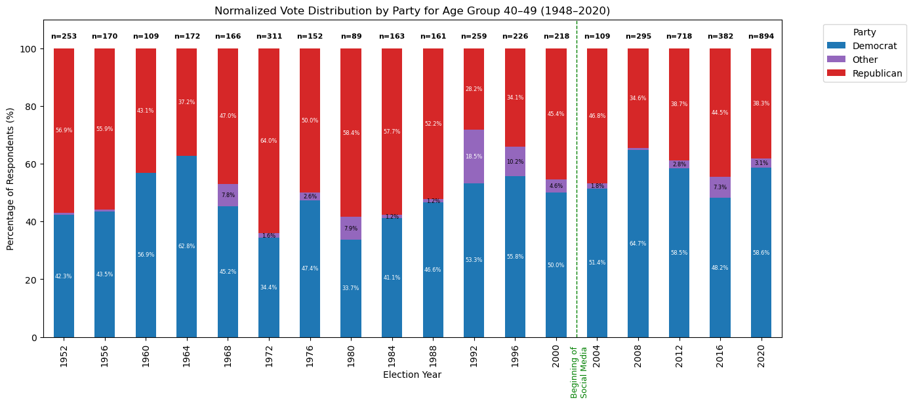
Political Views in the US
Sources: American National Election Studies (ANES) [6]

Slide 10
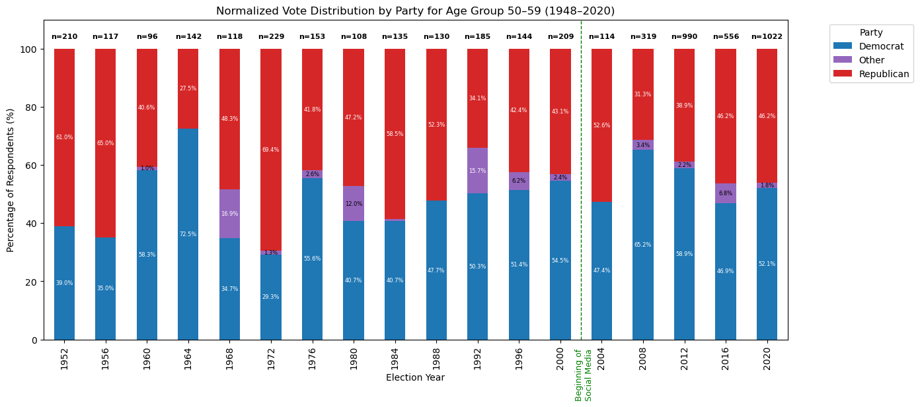
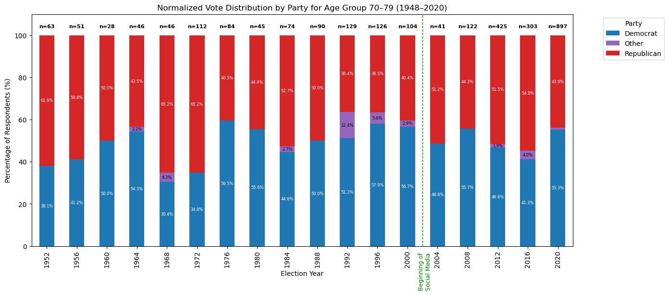
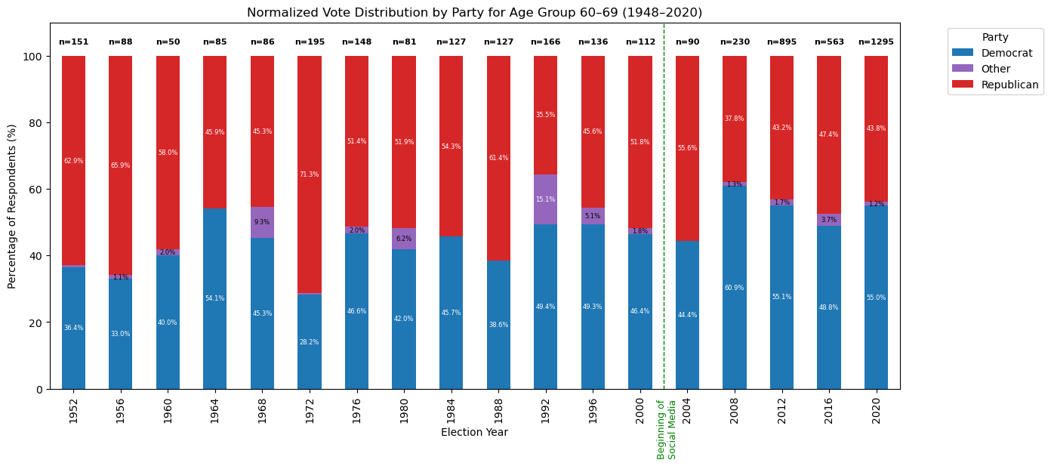
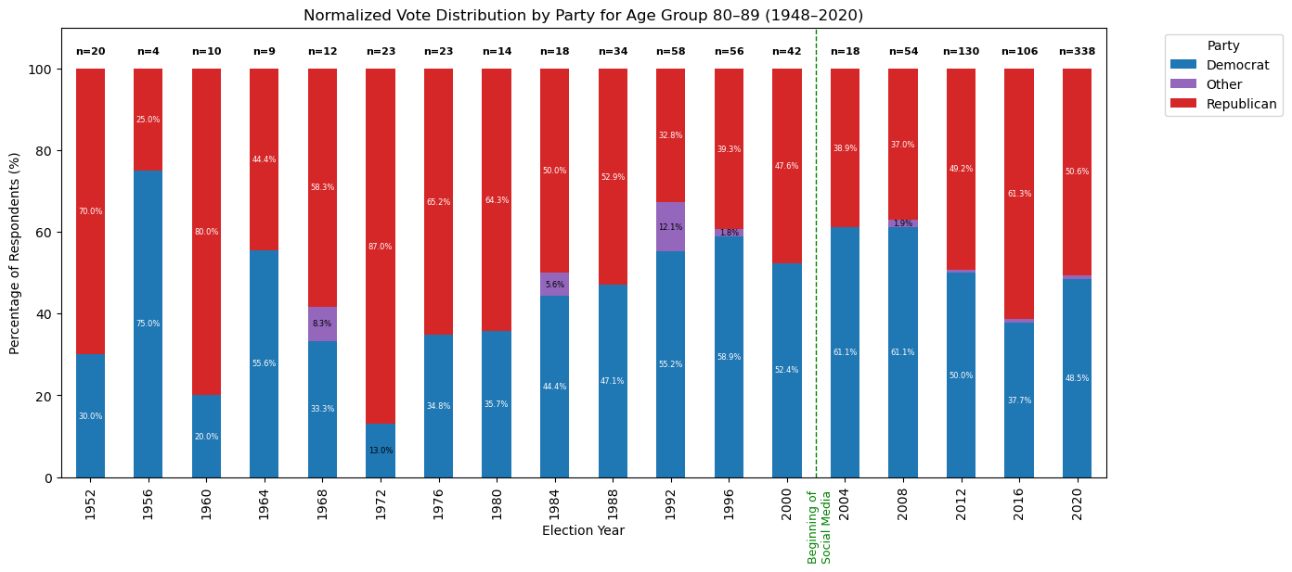
Political Views in the US
Sources: American National Election Studies (ANES) [6]

Slide 11
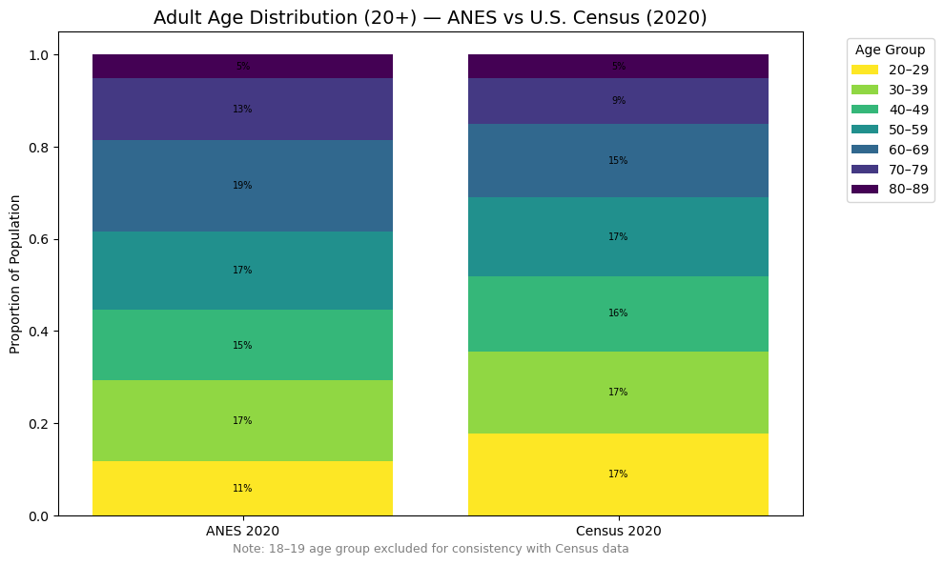
Political Views in the US
Sources: American National Election Studies (ANES) [6]; U.S. Census Bureau [7]

Slide 12
Building a Classification Model for Political Ideologies
Political Views in the US
Dataset to train the model:
General Social Survey (long-running sociological survey on American adults containing questions to numerous political subjects, including a self-reported political ideology -> label)
Simplifications:
Only three features (see later use case)
Binary classification to increase accuracy (liberal / conservative)
Ordinal encoding of variables
Model used for classifier:
Random forest classifier -> Grid search
Accuracy:
Approx. 72%

Slide 13
Application of the Classification Model
Political Views in the US
Monthly sentiment analysis on tweets concerning political topics (abortion, climate change and drug legalization, see later slides)
Map sentiment analysis to features of the classification model
Classify the “average monthly twitter user”
Time series

Slide 14
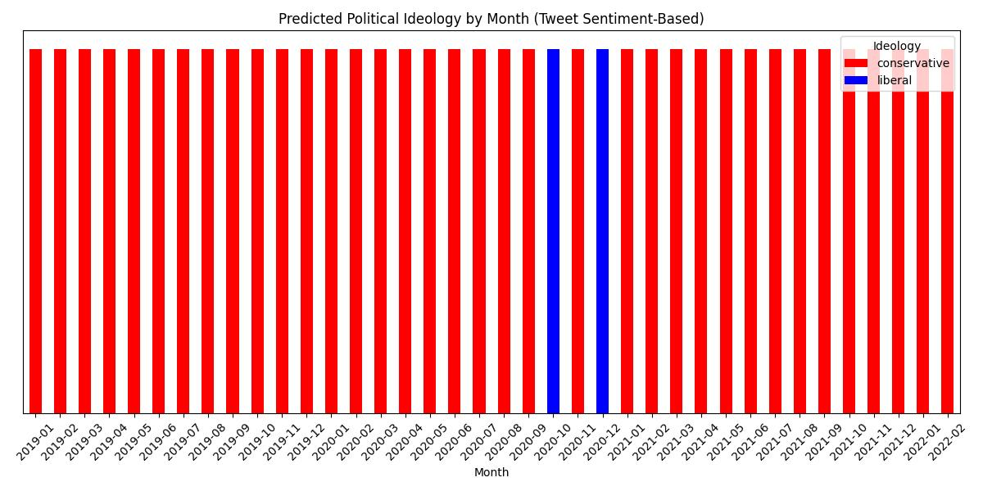
Political Views in the US
Time series

Slide 15
Political Views in the US
Main Takeaway
The average twitter user is conservative!
Take it with a pinch of salt!

Slide 16
Political Views in the US
We need to consider:
Very simple classification model
Very few features (3!)
Sentiment analysis yields very “neutral” scores most of the time -> Very large errors
Accuracy of model is not very high (only around 70 %)
More sophisticated model and analysis

Slide 17
Analysis - Part 2
Media & Social Media Coverage

Slide 18
Dataset
Media & Social Media Coverage
Newspapers: Proquest Database [3]
New York Times, Los Angeles Times,
Washington Post, Wall Street Journal
1970s - 2024
≅400K Sources (topic separated)
Social Media: General Social Media Archive (NORC) [4]
Social Data Explorer: Twitter
2019 - 2022
(Including sentiment Analysis - Vader)

Slide 19
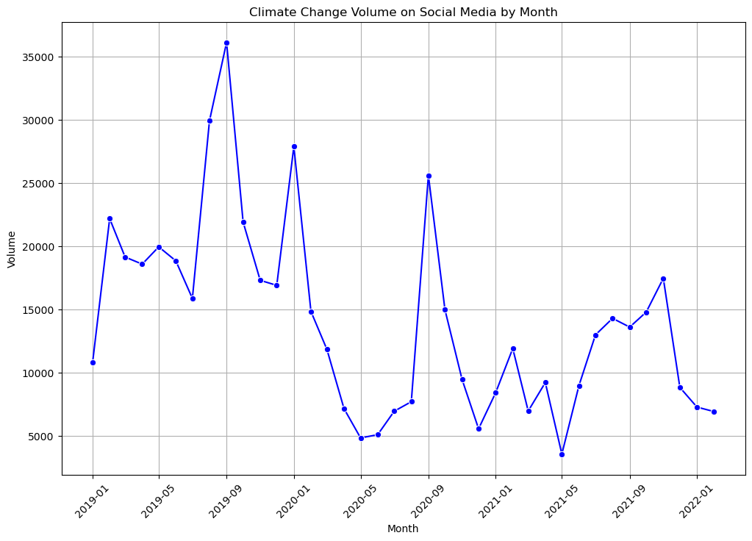
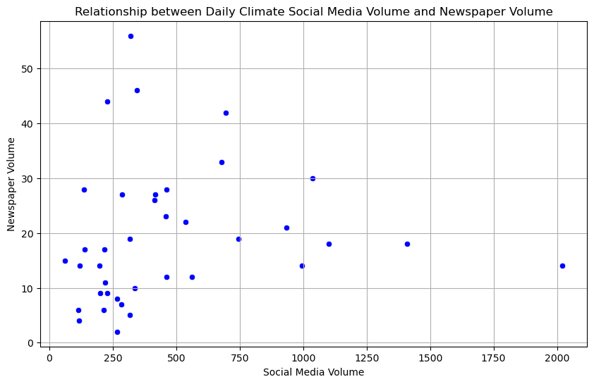
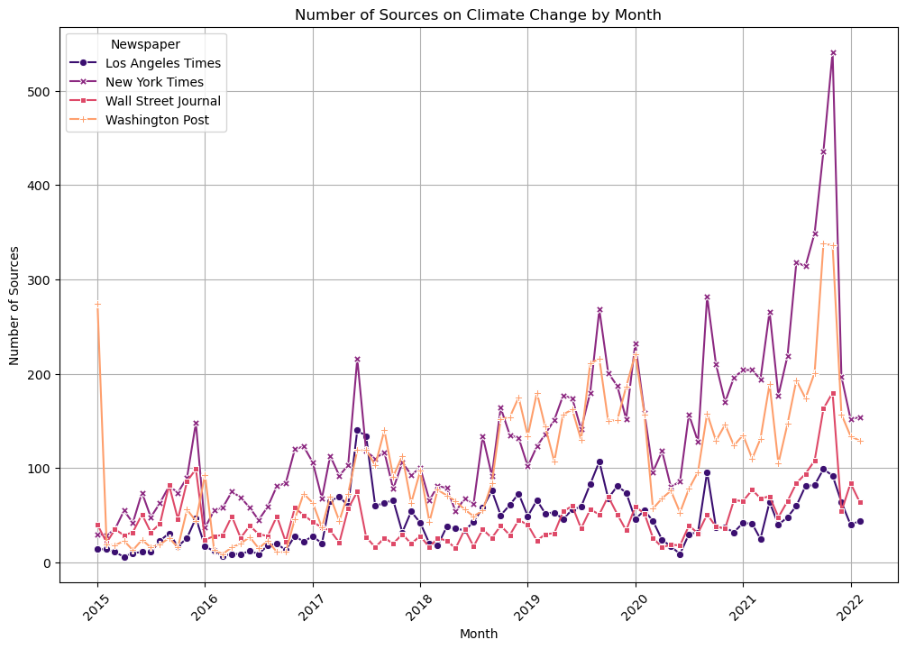
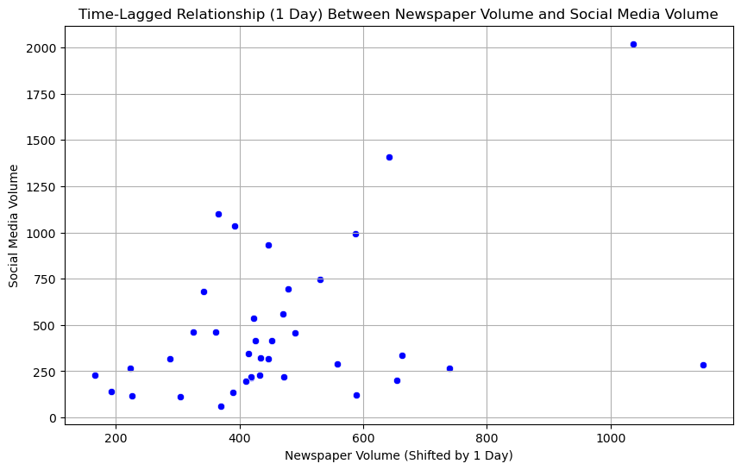
Climate Change
Media & Social Media Coverage
- Volume
Correlation ≈ 0.11
Direct Relationship
Correlation ≈ 0.396
Time-shifted Relationship (1-day)
Bigger correlation observed for monthly relationship

Slide 20
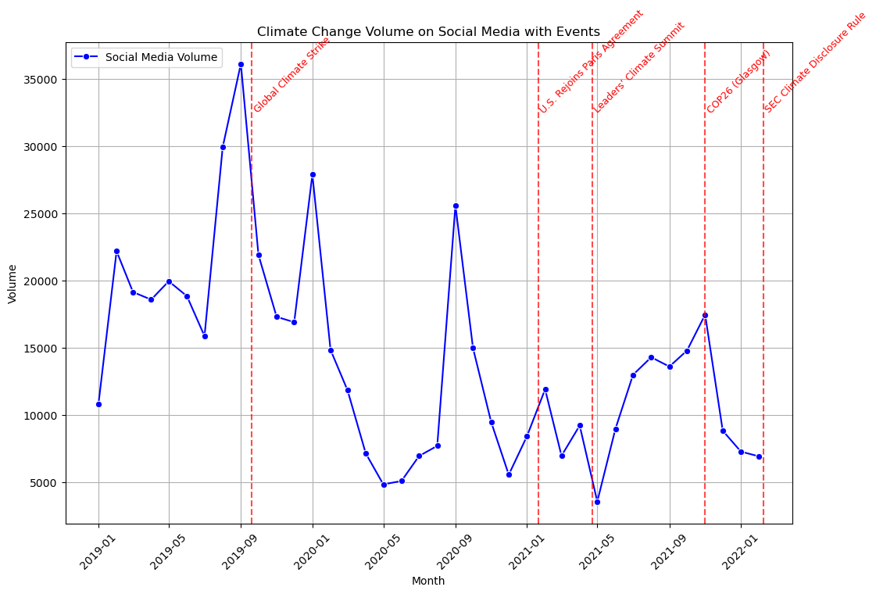
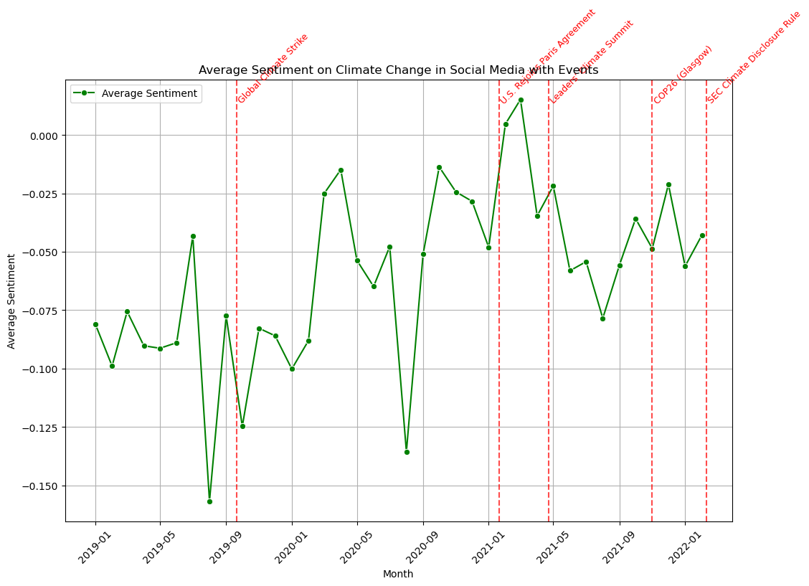
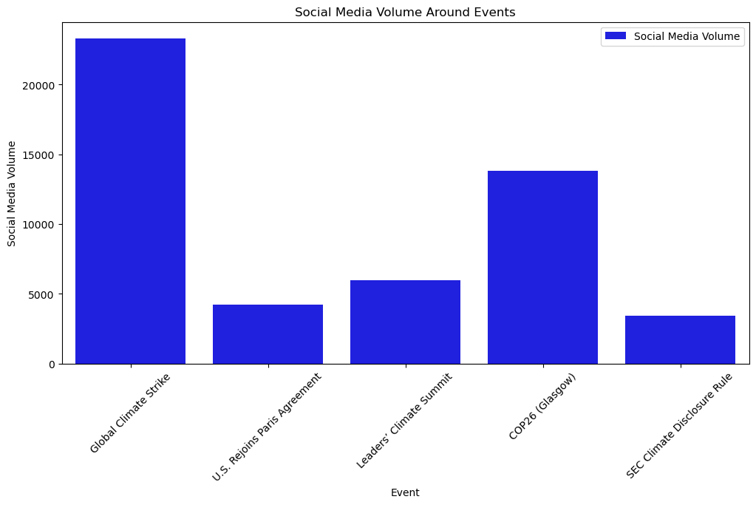
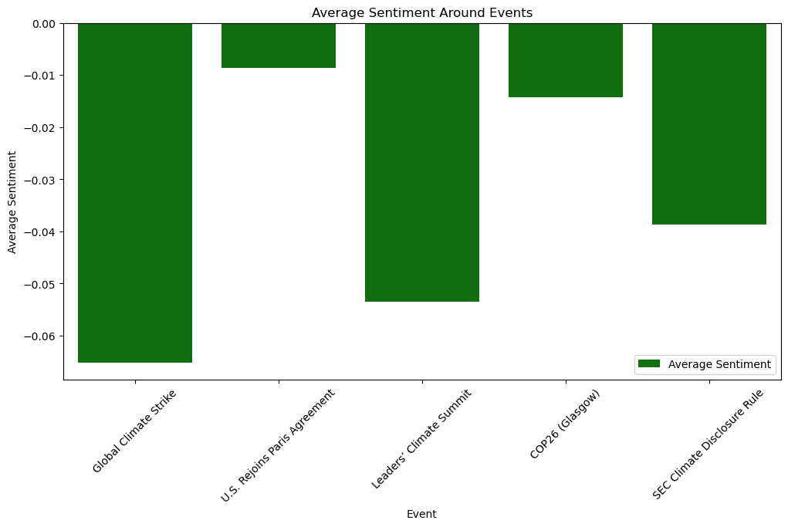
Climate Change
Media & Social Media Coverage
- Average sentiment (7 days) around events
Defining events on Climate Change

Slide 21
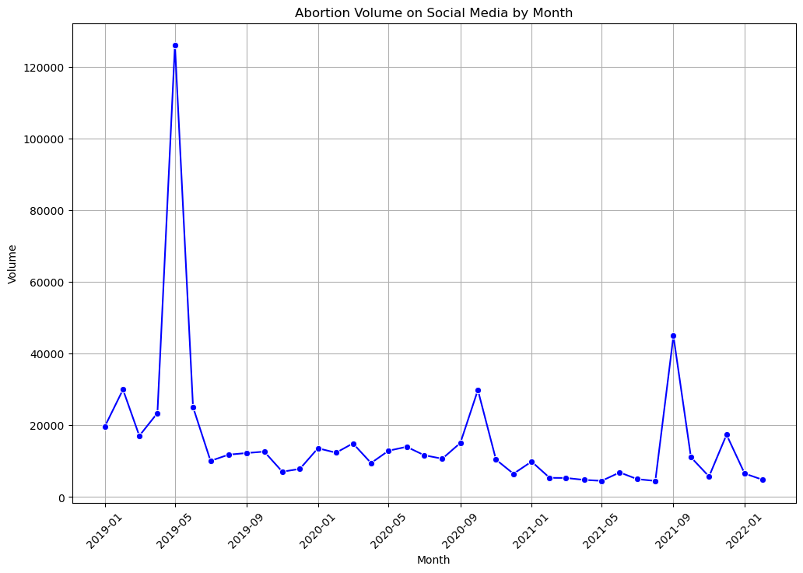
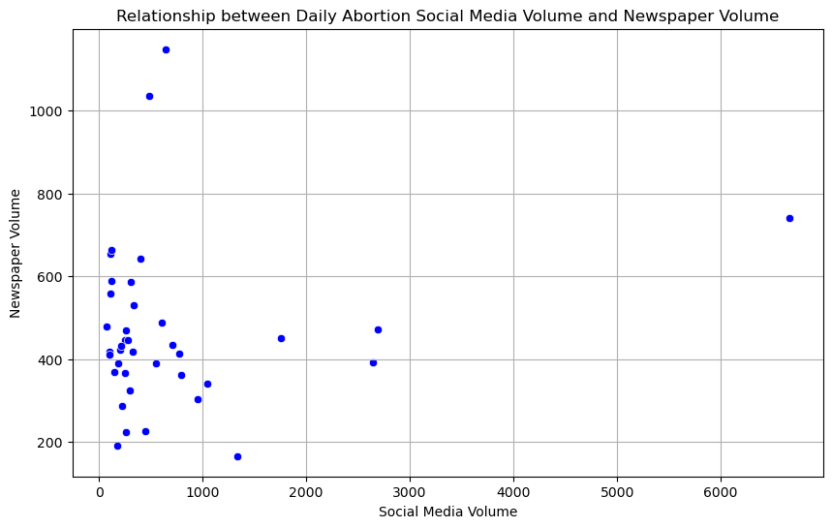
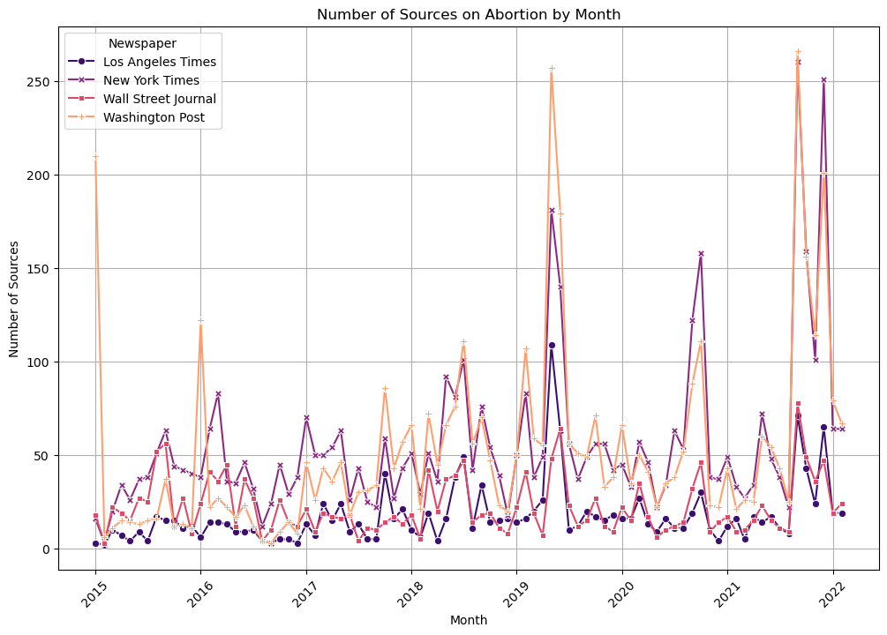
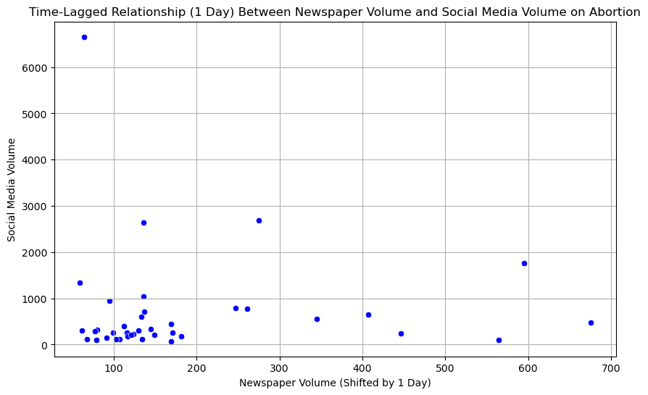
Abortion
Media & Social Media Coverage
- Volume
Correlation ≈ 0.15
Direct Relationship
Correlation ≈ -0.01
Time-shifted Relationship (1-day)
Bigger correlation observed for monthly relationship

Slide 22
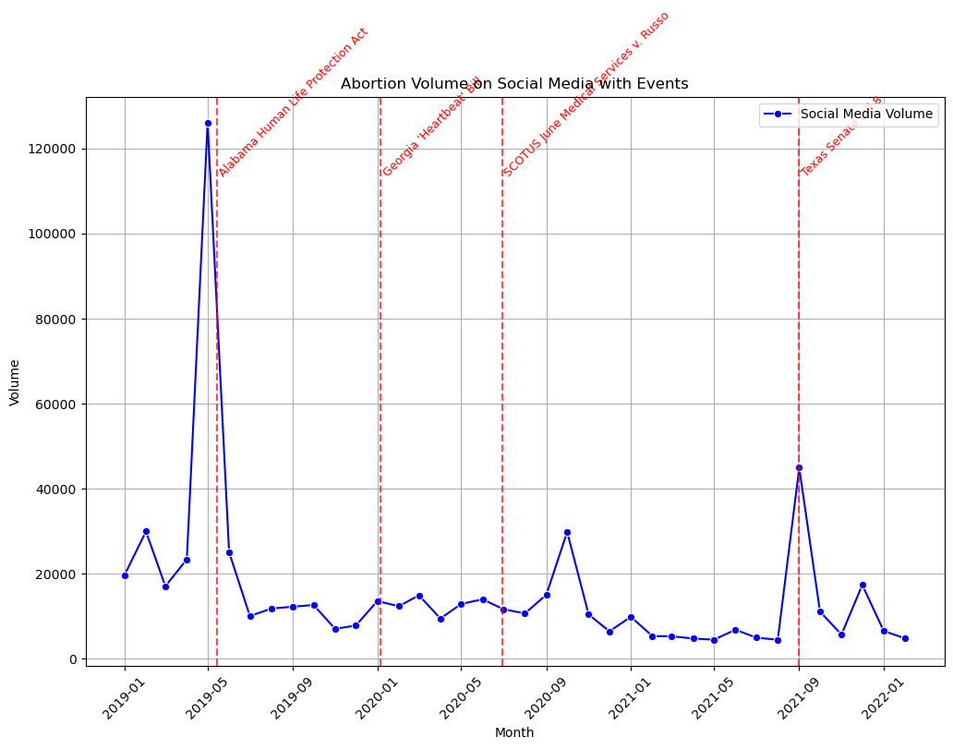
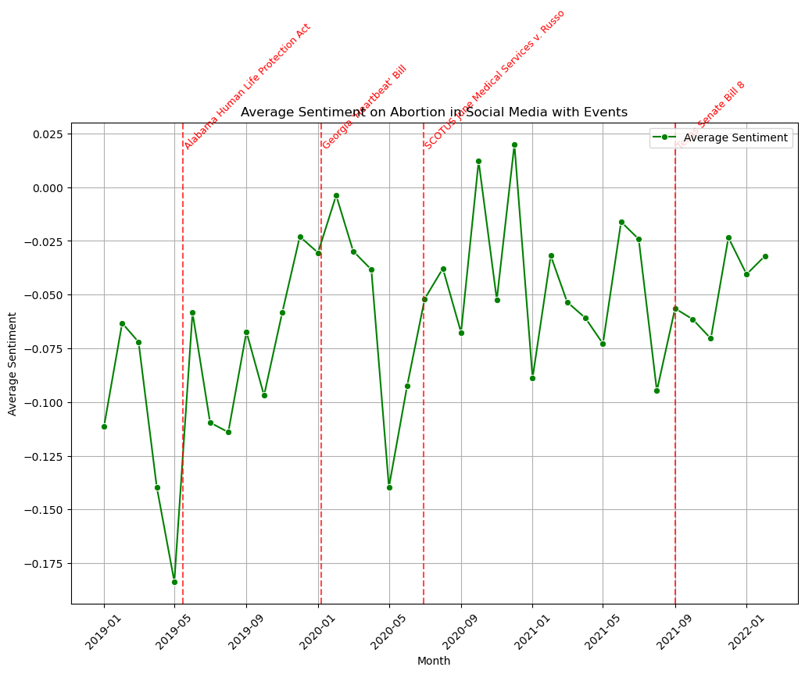
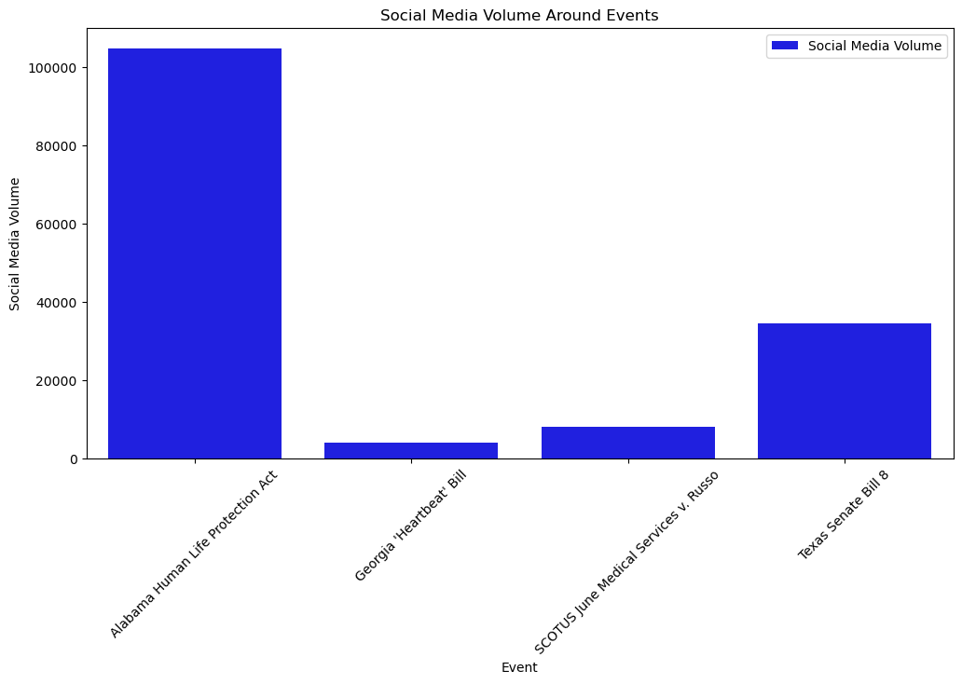
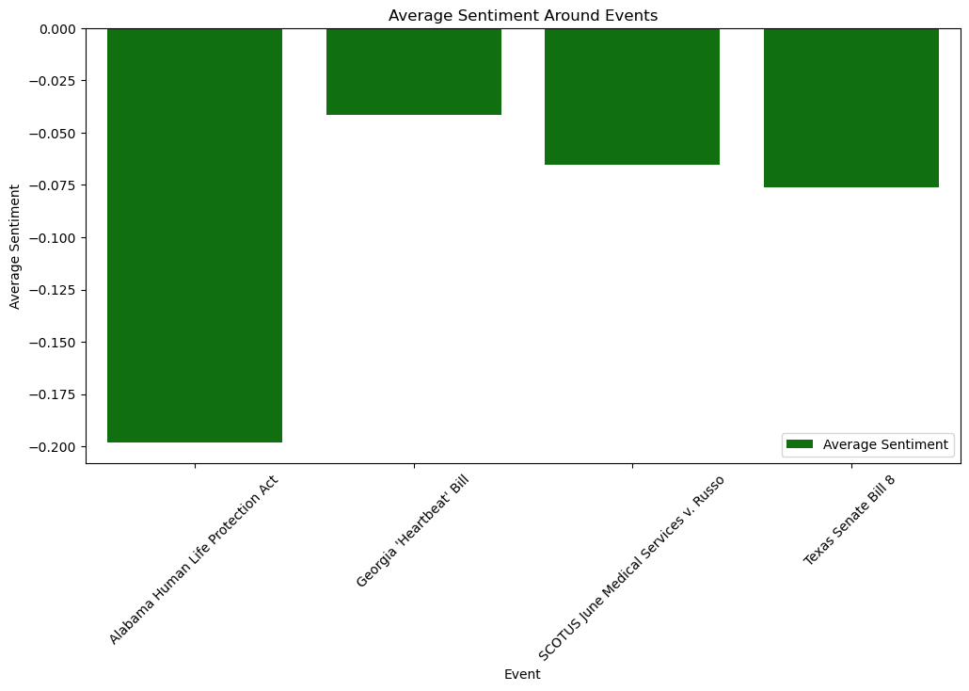
Abortion
Media & Social Media Coverage
- Average sentiment (7 days) around events
Defining events on Abortion Laws

Slide 23
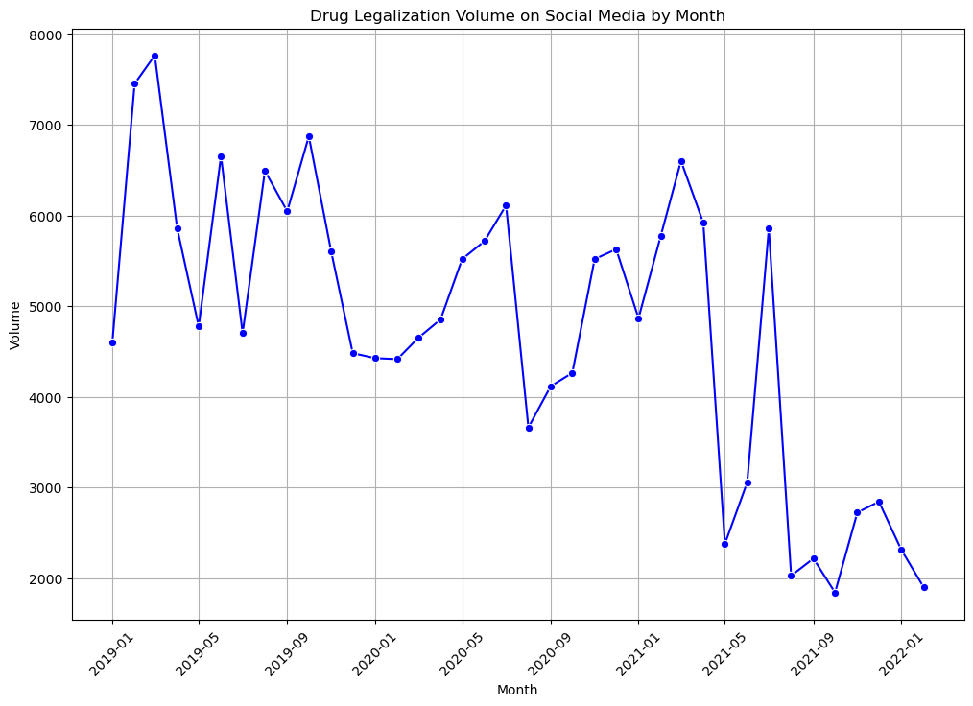
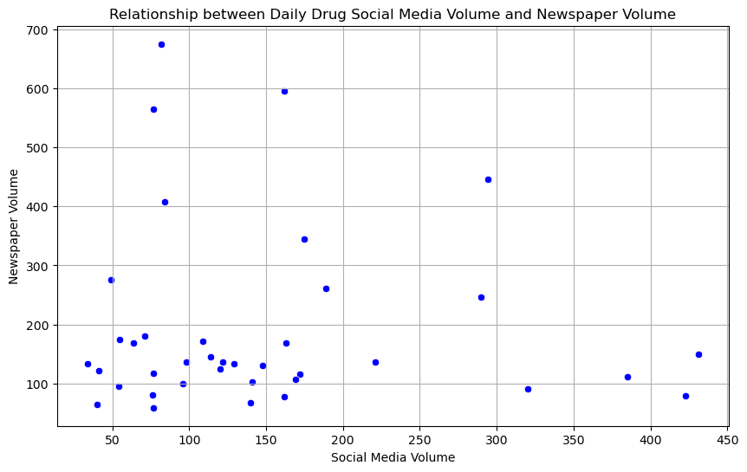
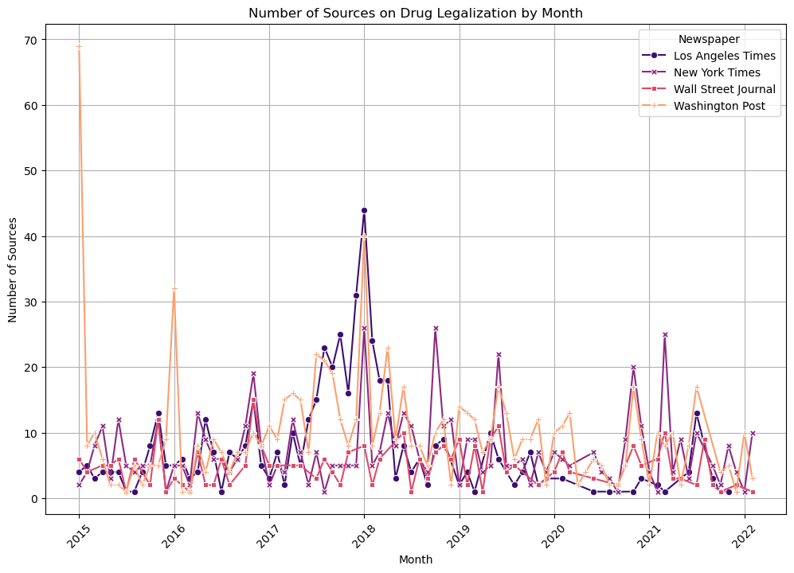
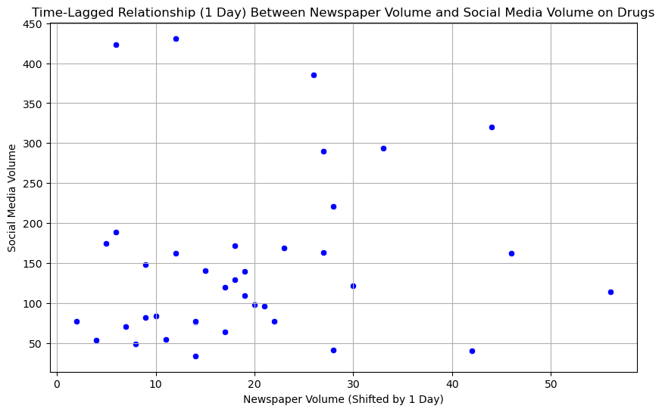
Drug Legalization
Media & Social Media Coverage
- Volume
Correlation ≈ -0.05
Direct Relationship
Correlation ≈ 0.14
Time-shifted Relationship (1-day)
Bigger correlation observed for monthly relationship

Slide 24
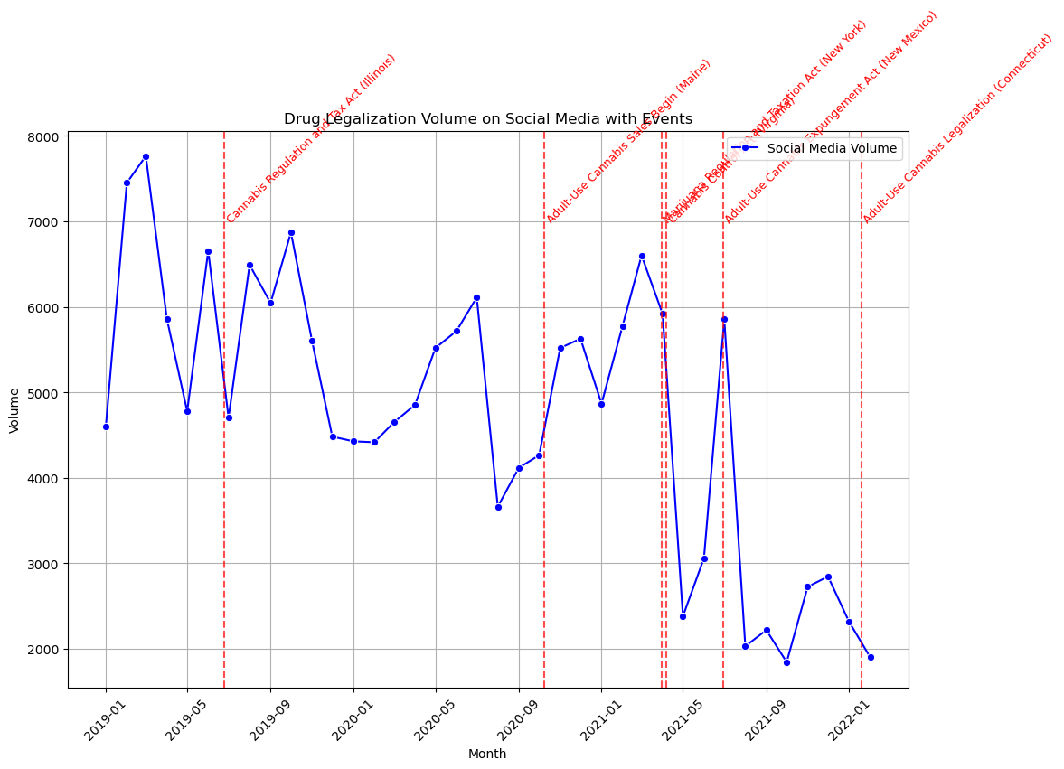
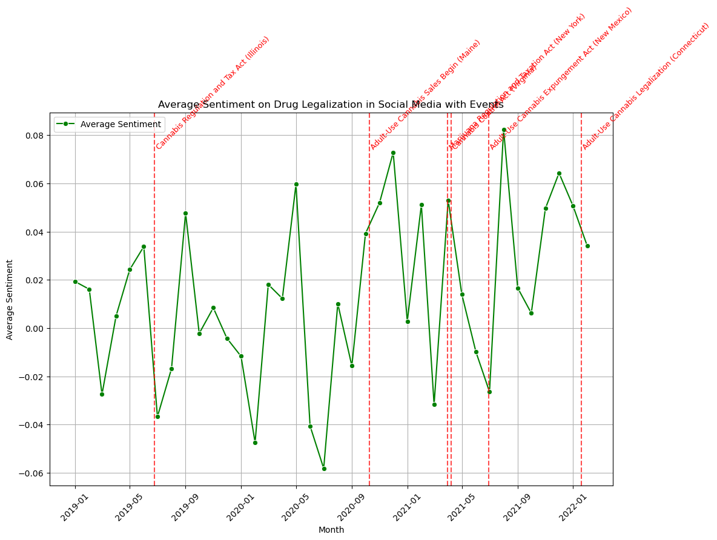
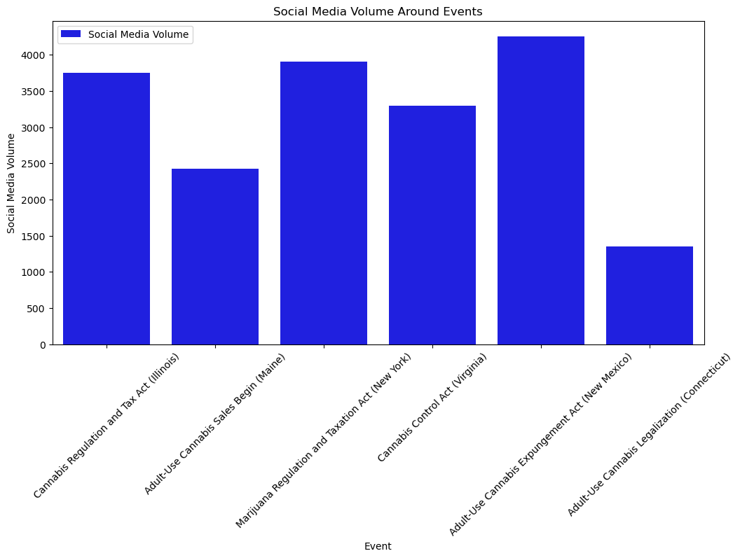
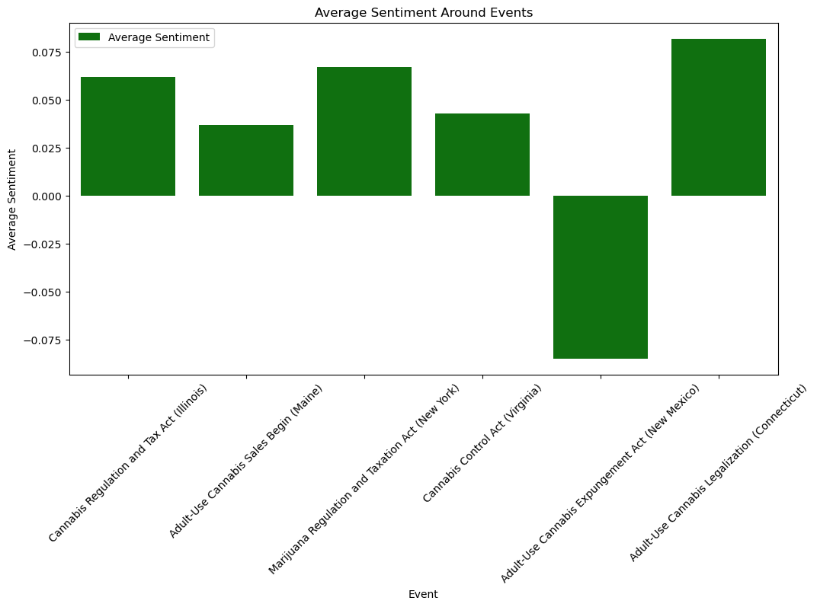
Drug Legalization
Media & Social Media Coverage
- Average sentiment (7 days) around events
Defining events on Drug Legalization

Slide 25
Partial Conclusions
Media & Social Media Coverage
- Volume Analysis & Time-Shifted analysis
Newspapers & Social media do not follow the same pace
Perspective plays a big role in interpretation: Monthly vs Daily
Event Analysis
Social Media debates can start before big events (laws, bills…)
Sentiments tend to pick up or abruptly change due to events

Slide 26
Analysis - Part 3
Social Network Opinion Spread

Slide 27
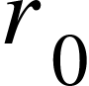
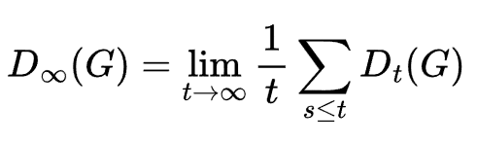
Simulate Opinion Spread
Social Network Opinion Spread
Opinion 1
Opinion 2
Opinion 3
Initialize Graph G by distributing a set of Opinions randomly
Propagate Opinions iteratively over Time using Innovation Index
Calculate Opinion Diversity..
.. at each Timestep t
.. at the end
adapt Opinion
innovate
r >
r ≤
“How networks shape diversity for better or worse”, Royal Society Open Science [7]

Slide 28
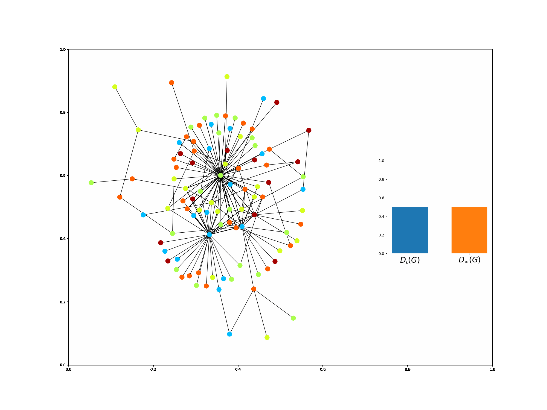
Simulate Opinion Spread
Social Network Opinion Spread

Slide 29
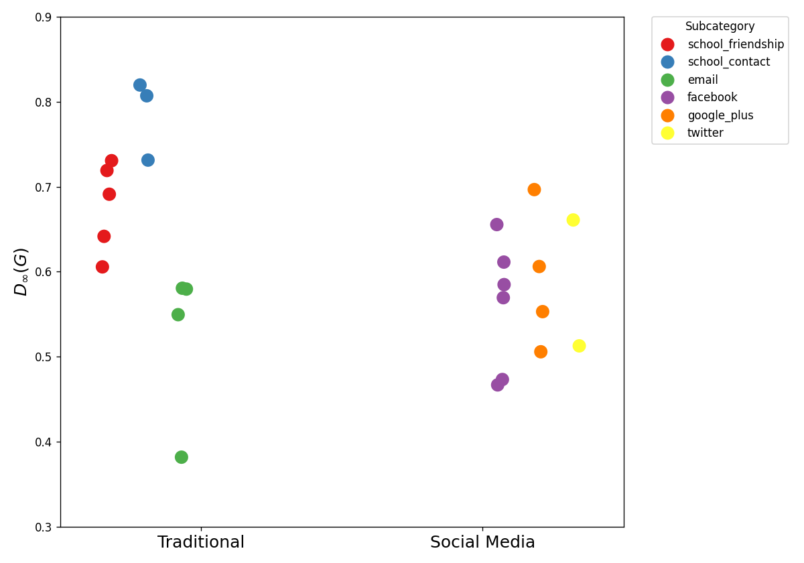
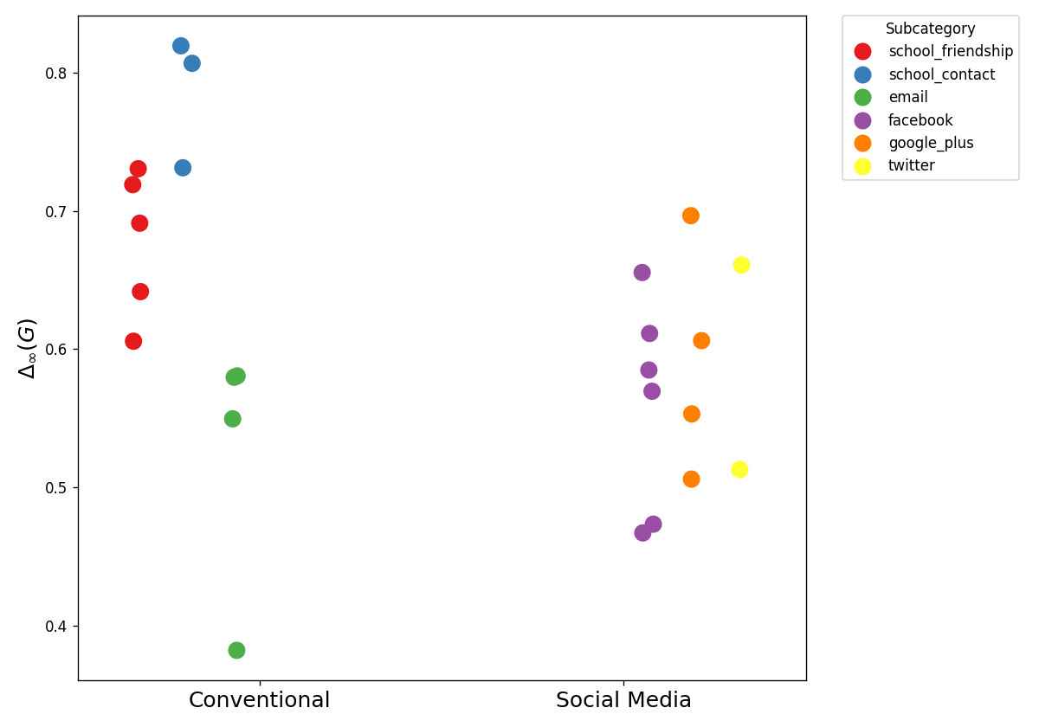
Application to Real-World Networks
Social Network Opinion Spread
Cumulative Diversity Index per Network Graph
Dataset
Friendship
Physical Proximity
Email
24 Network Graphs of
2 Categories
6 Subcategories
Preprocessed into Graphs with
400 Vertices
undirected / weightless Edges
Facebook
Google Plus
Twitter
Netzwerkschleuder: Graph Database by Tiago P. Peixoto [6]

Slide 30
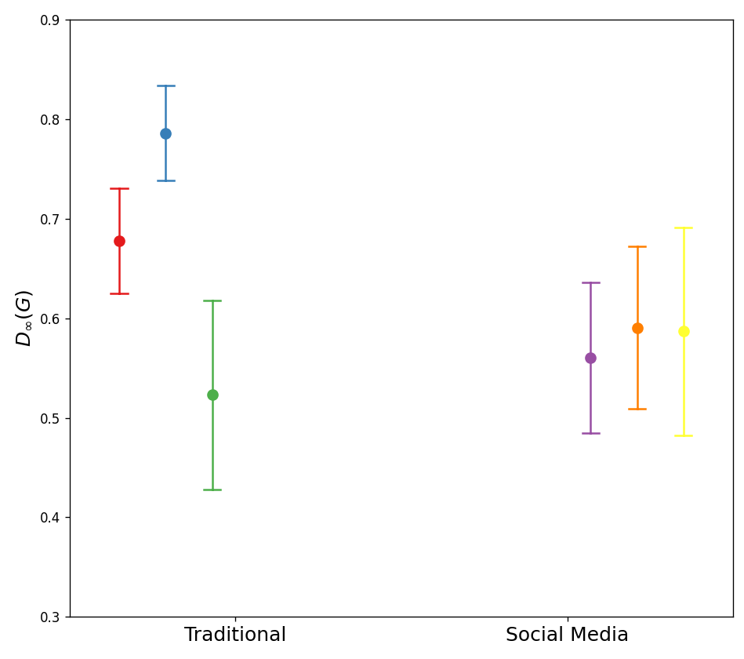
Application to Real-World Networks
Social Network Opinion Spread
Cumulative Diversity Index per Category
Findings
Friendship
Physical Proximity
Email
All Social Media Networks exhibit similar Opinion Diversity
Diversity Index of Social Media differs significantly from Physical Communication Graphs, tending to be lower
Facebook
Google Plus
Twitter

Slide 31
Limitations
Social Network Opinion Spread
Simplified Model to simulate Opinion Spread
Limited Access to Data representing Communication Networks realistically
Preprocessing and Selection of Graphs may bias the outcome

Slide 32
Conclusion
Based on the Graph Structure, Social Media Networks introduce changes in Opinion Spread
Traditional Media and Social Media show different dynamics on political debate: Social Media introduces earlier debates and more event-dependent sentiment
The sentiment detected by our social media classifier differs notably from that captured in election surveys, suggesting a discrepancy between online expression and surveyed public opinion.
There are changes in dynamics, mostly in forming opinions and debate opportunities, leading to faster changes in political opinions and involvement.
It is still necessary to consider the demographics on Social Media and further dynamics outside of it.
Hypothesis
“Social media has changed the spread of political information into a faster-changing and influenced-based environment.”

Slide 33
Future Work
Political Views In The US
Data not fully representative → needs weighting by race, gender, age
Media & Social Media Coverage
Include more topics of relevance
Gather and analyse newer and denser amount of data
Include sentiment analysis for Newspapers
Social Media Opinion Spread
Improve model’s complexity - portray dynamics more precisely

Slide 34
Sources
Data Reportal: Digital 2025: The United States of America: Accessed May 11, 2025
https://datareportal.com/reports/digital-2025-united-states-of-america [1]
Demand Sage: Twitter Statistics: Accessed May 11, 2025
https://www.demandsage.com/twitter-statistics/ [2]
ProQuest: NYT, LAT, WSJ, WP Newspaper Archives https://tdmstudio.proquest.com/ [3]
The General Social Survey: General Social media archive (NORC) https://gss.norc.org/us/en/gss/gsma.html [4]
Netzwerkschleuder: Graph Database by Tiago P. Peixoto
https://networks.skewed.de/ [5]
American National Election Studies (ANES), Time Series Cumulative Data File. Accessed May 11, 2025. https://electionstudies.org/data-center/anes-time-series-cumulative-data-file/ [6]
U.S. Census Bureau, U.S. Department of Commerce. "PROFILE OF GENERAL POPULATION AND HOUSING CHARACTERISTICS." Decennial Census, DEC Demographic Profile, Table DP1, 2020, https://data.census.gov/table/DECENNIALDP2020.DP1?q=2020+Census+Demographic+Profile+United+States. [7]
A.Musso, D. Helbing, “How networks shape diversity for better or worse”, Royal Society Open Science, May 2024 [8]

Slide 35
Any questions?
Ask away!

